Slide 1
Deep Learning Approaches for Fake News Detection: A Comprehensive Review

Slide 2
Group Members:
Avishkar Singh
Pratham Gupta
Shashwat Kumar Gautam
Jay Suthar
Akshat Ghariya
(IIT2020008)
(IIT2020026)
(IIT2020030)
(IIT2020087)
(IIT2020505)
Project Supervisor : Dr. Manish Kumar

Slide 3
What is Fake News?
“Fake news is a type of false information or propaganda that is intentionally spread through various media channels to misinform or deceive people”.
Fake news often has characteristics such as sensational headlines, emotionally charged language, lack of credible sources, and confirmation bias.
The motives behind spreading fake news may include financial gain, political manipulation, or simply creating chaos and confusion.
The impact of fake news can be significant, as it can influence public opinion, harm the reputation of individuals or organizations, and even pose a threat to national security.

Slide 4
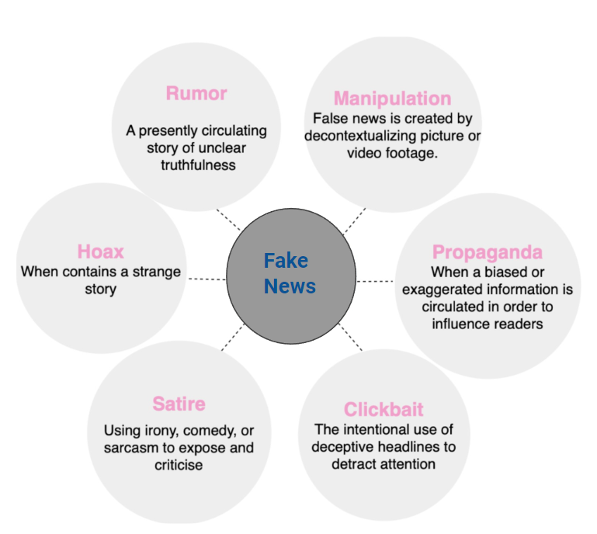
Types of Fake News

Slide 5
Objective
“With the rise of social media and the widespread dissemination of information, the spread of fake news has become a significant issue in society. As a result, various techniques have been developed to classify and identify fake news. However, it is unclear which technique is the most effective across different datasets. The objective of this project is to compare and evaluate the performance of different DL and NLP techniques on various datasets and determine which technique is the most effective for fake news classification”

Slide 6
Literature Review

Slide 7
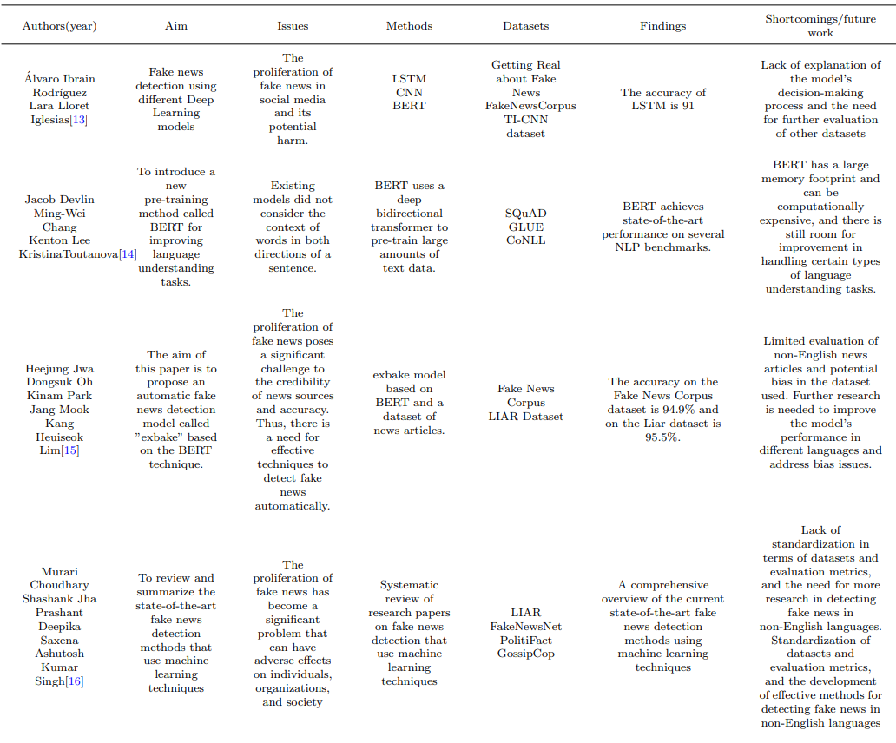

Slide 8
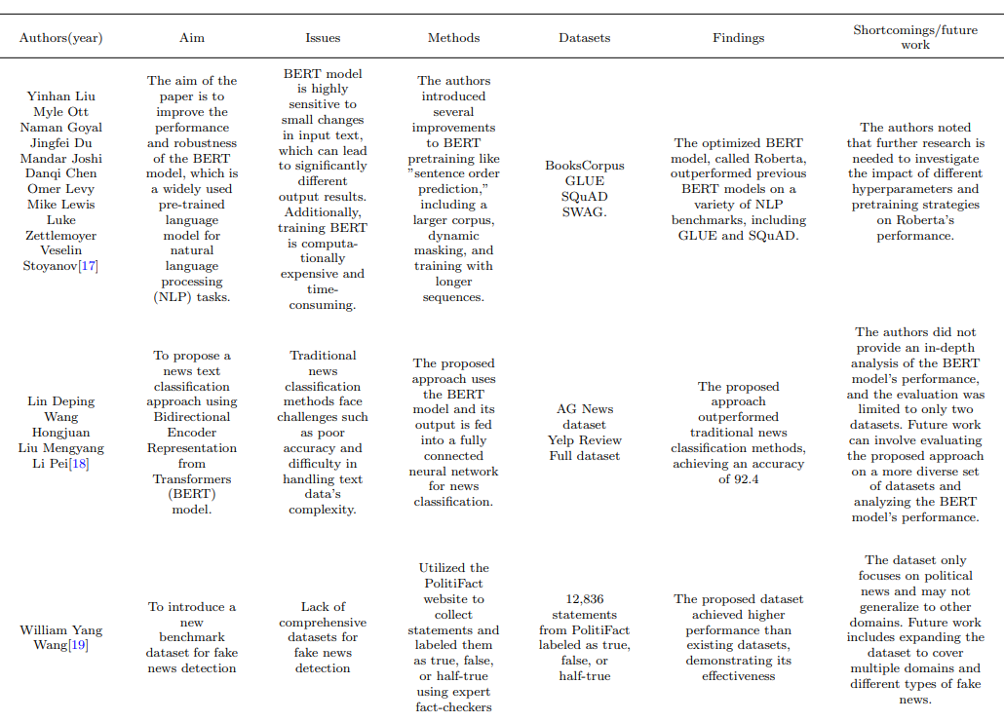

Slide 10
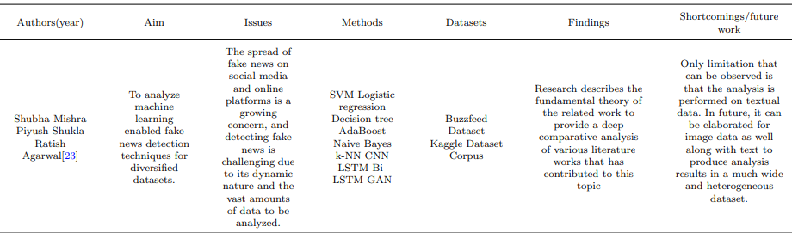

Slide 11
Why DL over ML in the field of Fake News Detection?

Slide 12
Deep learning models have the ability to automatically learn representations of data from raw input.
This is particularly beneficial for fake news detection because textual data can be complex and contain subtle patterns and features that may be difficult to capture using traditional machine learning models.
Deep learning models, such as neural networks, can automatically extract meaningful representations from text, allowing them to capture intricate relationships and subtle characteristics within the data.
Complex pattern recognition

Slide 13
End-to-End Learning
Deep learning models can learn directly from raw data, eliminating the need for manual feature engineering.
This end-to-end learning approach is beneficial in fake news detection, as it allows the model to automatically learn relevant features and representations directly from the text.
This reduces the reliance on handcrafted features and simplifies the overall model development process.

Slide 14
Scalability
Deep learning models are highly scalable and can effectively handle large amounts of data.
With the vast amount of textual data available on social media and online platforms, deep learning models can leverage big data to improve their performance in fake news detection.
One reason for the scalability of DL models is their parallel processing capability. Deep neural networks can leverage parallel architectures, such as graphics processing units (GPUs) or distributed computing frameworks, to accelerate the training and inference processes.
Feature Engineering: ML models often require manual feature engineering, where experts select and engineer relevant features from the data.
Which can be very difficult when we have a large dataset which further reduces scalability.

Slide 15
Methodology

Slide 16
Preprocessing
At first, we perform text cleaning operations such as making the text lowercase, removing text within square brackets, removing links, removing punctuation, removing newline characters, and removing words containing numbers.
Then we have removed the STOPWORDS which are words that are frequently occurring in a language but carry little or no significant meaning, such as "a," "the," "is," and "and.
Then we tokenize the text data using a tokenizer, converting words into sequences of integers.Then we pad or truncate the sequences to a fixed length of 100.

Slide 17
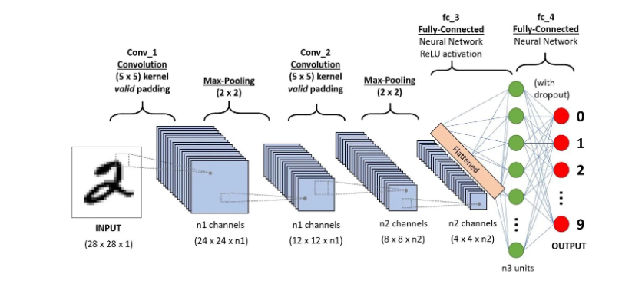
CNN (Convolutional Neural Network)
Ref: CNN model

Slide 18
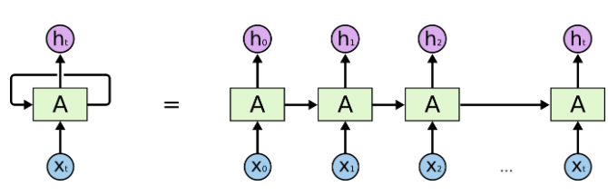
RNN (Recurrent Neural Network)
Ref : RNN

Slide 19
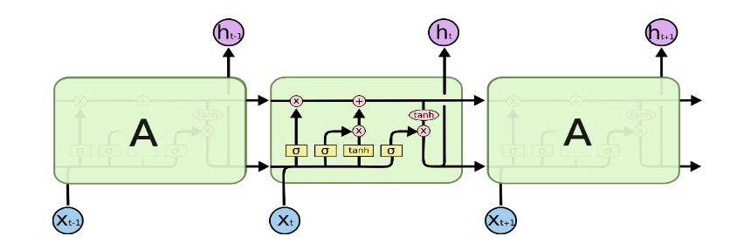
LSTM (Long-Short Term Memory)
Ref : LSTM

Slide 20
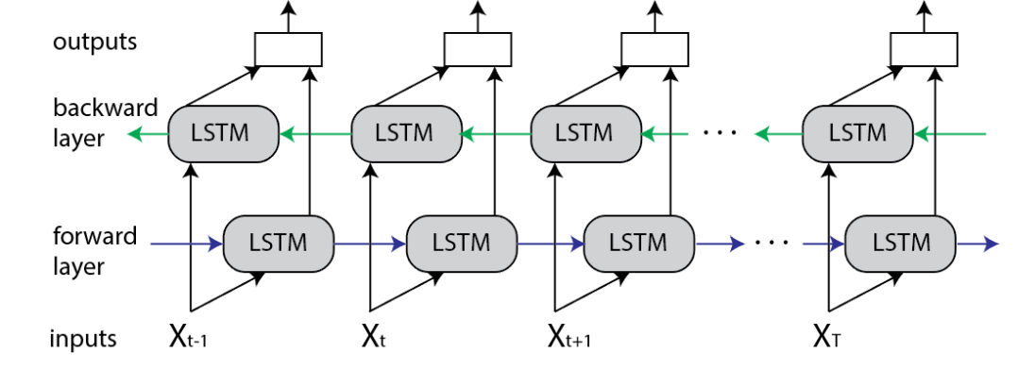
Bi - LSTM (Bidirectional Long-Short Term Memory)
Ref : Bi - LSTM

Slide 21
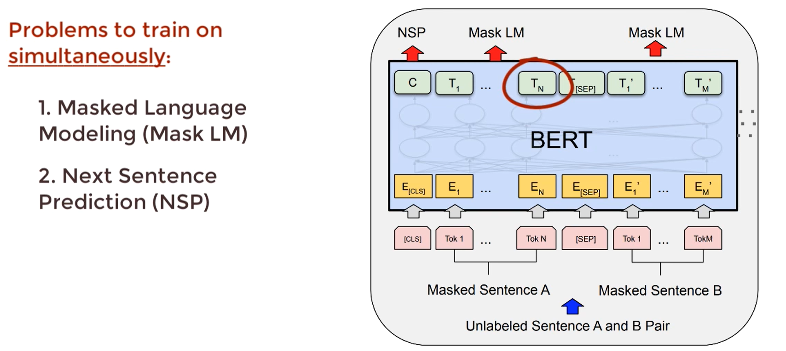
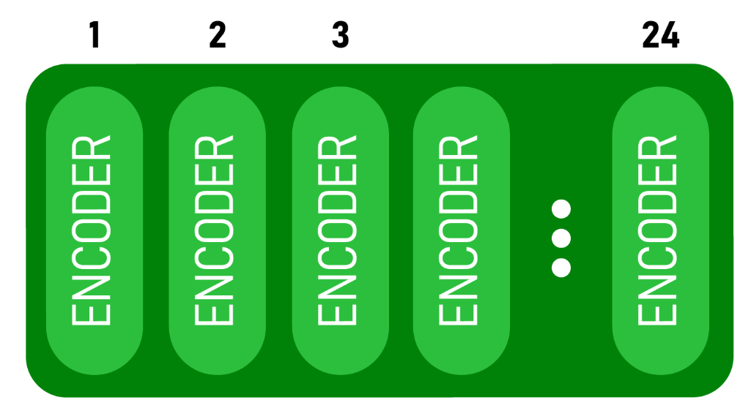
BERT
Ref : BERT

Slide 22
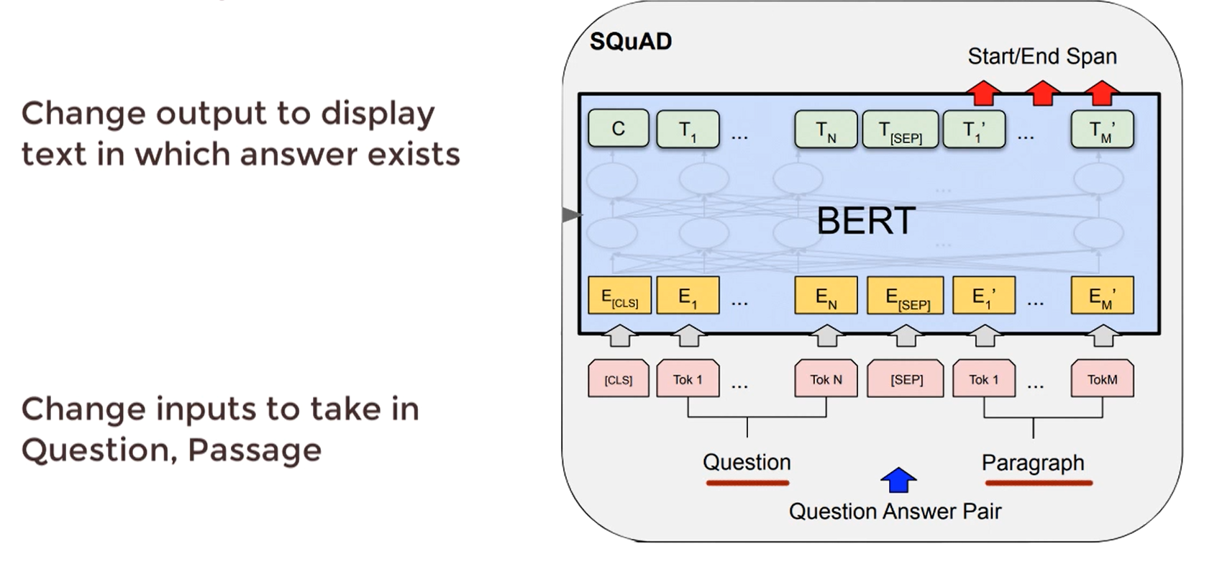
Fine Tuning - How to solve the task
Ref : BERT

Slide 23
Robustly optimized BERT training approach (RoBERTa)
This model is an improvised version of BERT, where it is trained using larger datasets, using high computational power.
Apart from using Wikipedia and Books Corpus data, the authors of the model have also used Common Crawl News data and Open Web text data in the pre-training part, which equaled about 160 GB of uncompressed text.
In the Masked Language Model task, authors used the concept of dynamic masking, where masking pattern is generated every time, a sequence is fed to the model, which yielded better results.
For Roberta, the Next Sentence Prediction (NSP) task is removed, which improved the performance of the downstream task.
Also, it is trained using large batch sizes and longer sequences. Using all these techniques, authors have optimized the BERT model, making it more robust for fine tuning it for downstream tasks.

Slide 24
Dataset
ISOT dataset -
Kaggle Fake News Dataset
WELLFake dataset
Liar Liar Dataset

Slide 25
Kaggle Fake News Dataset -
The dataset contains over 20,000 news articles that are labeled as either ”real” or ”Fake”. The dataset contains the following attributes:
id: unique id for a news article
title: the title of a news article
author: author of the news article
text: the text of the article; could be incomplete
label: a label that marks the article as potentially unreliable
1: unreliable
0: Reliable

Slide 26
ISOT dataset -
The Canadian University of Victoria’s research team produced the dataset, which will be used to study the issue of identifying false news. There are two CSV files in it.
The first file is “True.csv”, with all the reliable news.
The second file is“Fake.csv”, with all the fake news.
The dataset contains the following attributes:
Title: the title of a news article
Text: the text of the article; could be incomplete
Subject: subject of the article
Date: The date that this article was posted at

Slide 27
Liar Liar Dataset -
There are three CSV files in it. The first file is “test.tsv” , the second file is“train.tsv” , the third file is “valid.tsv”
The dataset contains the following attributes:
Column 1: the ID of the statement ([ID].json).
Column 2: the label.
Column 3: the statement.
Column 4: the subject(s).
Column 5: the speaker.
Column 6: the speaker's job title.
Column 7: the state info.
Column 8: the party affiliation.
Columns 9-13: the total credit history count, including the current statement.
9: barely true counts.
10: false counts.
11: half true counts.
12: mostly true counts.
13: pants on fire counts.
Column 14: the context (venue/location of the speech or statement).

Slide 28
WELLFake dataset-
The dataset contains the following attributes:
title: the title of a news article
text: the text of the article; could be incomplete
Label: 1 for true, 0 for false

Slide 29
Results
(Accuracy, Precision, F1 Score, Recall, Confusion Matrix)

Slide 30
DATASET | MODELS | EVALUATION PARAMETERS
 |  | ACCURACY | PRECISION | RECALL | F1-SCORE
ISOT | CNN | 98.74 | 99 | 99 | 99
 | LSTM | 98.77 | 99 | 99 | 99
 | Bi-LSTM | 98.84 | 99 | 99 | 99
 | BERT | 99.76 | 100 | 100 | 100
 | ROBERTA | 99.84 | 100 | 100 | 100
KAGGLE FAKE NEWS | CNN | 94.87 | 95 | 95 | 95
 | LSTM | 94.67 | 95 | 95 | 95
 | Bi-LSTM | 94.95 | 95 | 95 | 95
 | BERT | 98.43 | 98 | 98 | 98
 | ROBERTA | 98.28 | 98 | 98 | 98
LIAR FAKE NEWS DATASET | CNN | 56.51 | 51 | 50 | 50
 | LSTM | 55.48 | 50 | 50 | 50
 | Bi-LSTM | 53.67 | 49 | 49 | 49
 | BERT | 66.89 | 62 | 63 | 62
 | ROBERTA | 67.95 | 64 | 65 | 64
WELFake | CNN | 94.65 | 95 | 95 | 95
 | LSTM | 95.11 | 95 | 95 | 95
 | Bi-LSTM | 95.03 | 95 | 95 | 95
 | BERT | 99.04 | 99 | 99 | 99
 | ROBERTA | 99.64 | 100 | 100 | 100

Slide 31
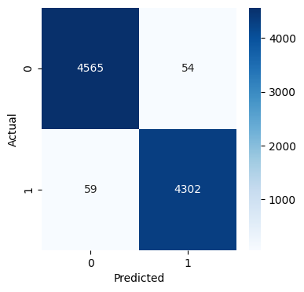


ISOT Confusion Matrix
CNN
LSTM
Bi-LSTM

Slide 32


ISOT Confusion Matrix Cont’d
BERT
RoBERTa

Slide 33
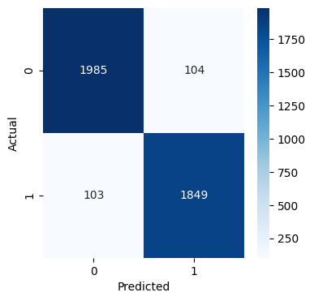


Kaggle Fake News Confusion Matrix
CNN
LSTM
Bi-LSTM

Slide 34


Kaggle Fake News Confusion Matrix Cont’d
BERT
RoBERTa

Slide 35
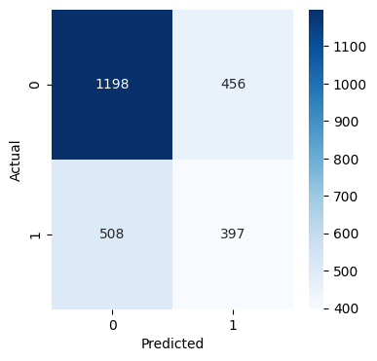
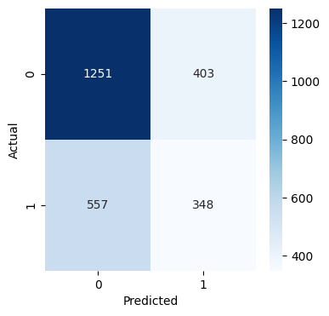

Liar Liar Confusion Matrix
CNN
LSTM
Bi-LSTM

Slide 36
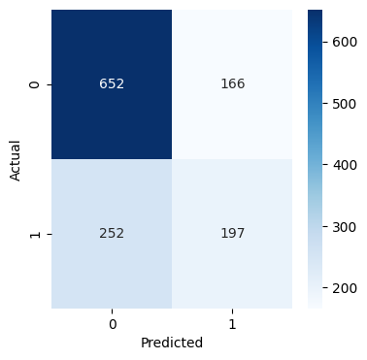
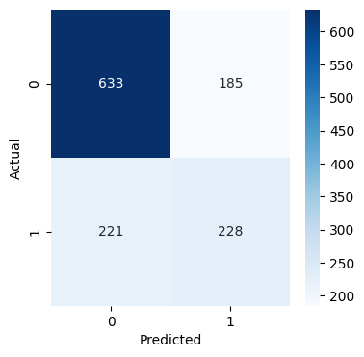
Liar Liar Confusion Matrix Cont’d
BERT
RoBERTa

Slide 37
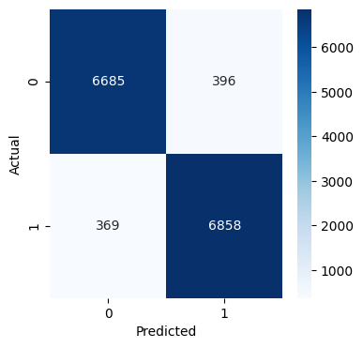
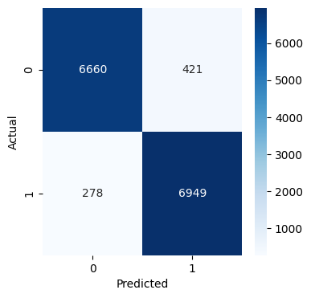

WELFake Confusion Matrix
CNN
LSTM
Bi-LSTM

Slide 38
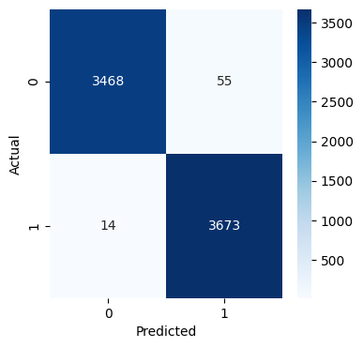

WELFake Confusion Matrix Cont’d
BERT
RoBERTa

Slide 39
Conclusion:
Deep learning approaches have shown great potential in detecting fake news due to their ability to automatically extract complex features from textual and non-textual data.
Among the various deep learning models, Convolutional Neural Networks (CNNs) and Recurrent Neural Networks (RNNs), BERT, ROBERTA are the most commonly used models for fake news detection. However, the performance of these models heavily relies on the quality of the input data and the selection of appropriate features.
Therefore, future work need to focus on the development of robust and efficient deep learning models for fake news detection, which can help to combat the spread of misinformation on social media and online platforms.

Slide 40
Workflow
Assignment of topic for project under Dr. Manish Kumar
C2 project evaluation and presentation
C1 evaluation of Mini-project
25.01.2023
14.02.2023
28.02.2023
01.03.2023
26.04.2023
11.05.2023
First Progress visit and started studying different models
Pre Processing and implementing the models, started working on the project report
Presentation of complete study for C3 Evaluation of Mini-project

Slide 41
References
[1] A. Gelfert, Fake news: A definition. Informal Logic, 2018.
[2] P. B. J.-c. G. J. O. M. R. Melanie Freeze, Mary Baumgartner, J. Szafran., Fake claims of fake news: Political misinformation, warnings, and the tainted truth effect. (02 2020).
[3] Z.-H. Zhou., A brief introduction to weakly super- vised learning. national science review (2017) 44–53.
[4] K. M. Yazdi, A. M. Yazdi, S. Khodayi, J. Hou, W. Zhou, S. Saedy, Improving fake news detection using k-means and support vector machine approaches, International Journal of Electronics and Communication Engineering 14 (2) (2020) 38–42.
[5] R. Zhao, K. Mao, Fuzzy bag-of-words model for document representation, IEEE transactions on fuzzy systems 26 (2) (2017) 794–804.
[6] S. Ahmed, K. Hinkelmann, F. Corradini, Development of fake news model using machine learning through natural language processing, arXiv preprint arXiv:2201.07489 (2022).
[7] K. Poddar, K. Umadevi, et al., Comparison of various machine learning models for accurate detection of fake news, in: 2019 Innovations in Power and Advanced Computing Technologies (i-PACT), Vol. 1, IEEE, 2019, pp. 1–5. 47
[8] A. Kesarwani, S. S. Chauhan, A. R. Nair, Fake news detection on social media using k-nearest neighbor classifier, in: 2020 international conference on advances in computing and communication engineering (ICACCE), IEEE, 2020, pp. 1–4.
[9] N. L. S. R. Krishna, M. Adimoolam, Fake news detection system using logistic regression and compare textual property with support vector machine algorithm, in: 2022 International Conference on Sustainable Computing and Data Communication Systems (ICSCDS), IEEE, 2022, pp. 48–53.

Slide 42
[10] J. Shaikh, R. Patil, Fake news detection using machine learning, in: 2020 IEEE International Symposium on Sustainable Energy, Signal Processing and Cyber Security (iSSSC), IEEE, 2020, pp. 1–5.
[11] A. Albahr, M. Albahar, An empirical comparison of fake news detection using different machine learning algorithms, International Journal of Advanced Computer Science and Applications 11 (9) (2020).
[12] K. M. Yazdi, A. M. Yazdi, S. Khodayi, J. Hou, W. Zhou, S. Saedy, Improving fake news detection using k-means and support vector machine approaches, International Journal of Electronics and Communication Engineering 14 (2) (2020) 38–42.
[13] A. Ibrain Rodr´ıguez, L. Lloret Iglesias, Fake news detection using deep learning, ´ arXiv e-prints (2019) arXiv–1910.
[14] J. Devlin, M.-W. Chang, K. Lee, K. Toutanova, Bert: Pre-training of deep bidirectional transformers for language understanding, arXiv preprint arXiv:1810.04805 (2018).
[15] H. Jwa, D. Oh, K. Park, J. M. Kang, H. Lim, exbake: Automatic fake news detection model based on bidirectional encoder representations from transformers (bert), Applied Sciences 9 (19) (2019) 4062.
[16] M. Choudhary, R. Jain, A. Gupta, R. Kumar, N. Prakash, A review of fake news detection methods using machine learning, in: 2021 2nd International Conference for Emerging Technology (INCET), IEEE, 2021.
[17] Y. Liu, M. Ott, N. Goyal, J. Du, M. Joshi, D. Chen, O. Levy, M. Lewis, L. Zettlemoyer, V. Stoyanov, Roberta: a robustly optimized bert pretraining approach (2019), arXiv preprint arXiv:1907.11692 364 (1907).
[18] L. Deping, W. Hongjuan, L. Mengyang, L. Pei, News text classification based on bidirectional encoder representation from transformers, in: 2021 International Conference on Artificial Intelligence, Big Data and Algorithms (CAIBDA), IEEE, 2021, pp. 137–140.

Slide 43
[19] W. Y. Wang, ” liar, liar pants on fire”: A new benchmark dataset for fake news detection, arXiv preprint arXiv:1705.00648 (2017).
[20] A. D’Ulizia, M. C. Caschera, F. Ferri, P. Grifoni, Fake news detection: a survey of evaluation datasets, PeerJ Computer Science 7 (2021) e518.
[21] A. Mohapatra, N. Thota, P. Prakasam, Fake news detection and classification using hybrid bilstm and self-attention model, Multimedia Tools and Applications 81 (13) (2022) 18503–18519.
[22] R. Jain, D. K. Jain, N. Sharma, Fake news classification: A quantitative research description, Transactions on Asian and Low-Resource Language Information Processing 21 (1) (2021) 1–17.
[23] S. Mishra, P. Shukla, R. Agarwal, Analyzing machine learning enabled fake news detection techniques for diversified datasets, Wireless Communications and Mobile Computing 2022 (2022) 1–18.

Slide 44
Thank
You

